Slide 1



Introduction to Voting System Project
The voting system project is aimed at creating a unified software platform to manage the entire election process. It includes features for personnel management, candidate registration, voting procedures, and result generation. The project is implemented in C programming language, which is widely recognized and utilized by major technology companies like Microsoft. The use of C is advantageous as it ensures compatibility and portability across different platforms, making it an ideal choice for this project.
by Atul Dhital

Slide 2
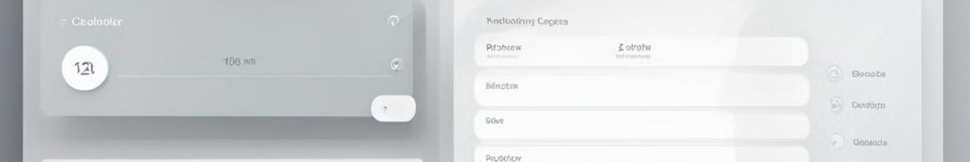
Admin Features
1
Admin Login
The admin can log in using a passcode to access the dashboard.
2
Create Election Schedule
Enables the admin to input details regarding an electoral area and its election date.
3
Manage Candidates
Allows the admin to add, update, or remove candidates from the list.

Slide 3
Admin Task - Manage Candidates
Add Candidate
Update Candidate
Delete Candidate
Enables the admin to add candidates for the election by inputting their name, party, and address.
Facilitates the admin to update candidate details by entering the candidate's name.
Allows the admin to remove candidates from the list by entering their name.

Slide 4

Admin Task - Register Voter
1
Register New Voters
2
Age Verification
Admins can register new voters by providing their serial number, name, date of birth, address, and password.
Admins will ensure that voters are at least 18 years old.

Slide 5

Admin Task - Update Voter Details
Update Voter Data
Admins can modify voter data by entering the voter's serial number and updating the necessary information.

Slide 6

Admin Task - Search Voter Details
Search by Serial Number
Admins can locate and display details about a voter using their unique serial number.

Slide 7


Admin Task - Display Vote Results
Publish Vote Results
Allows the admin to officially publish the voting results.

Slide 8
Voter Dashboard
Register to Vote
Edit Your Profile
Display Your Vote
Enables voters to cast their vote under secure authentication.
Allows voters to update their personal information and details.
Gives the option for voters to view their casted vote details.

Slide 9

Implementation of Functions
1
File: Generate and Admin Password
2
Authentication for User Login
Provides a secure login process for both admin and voters.
Includes features for generating and validating admin passwords.

Slide 10
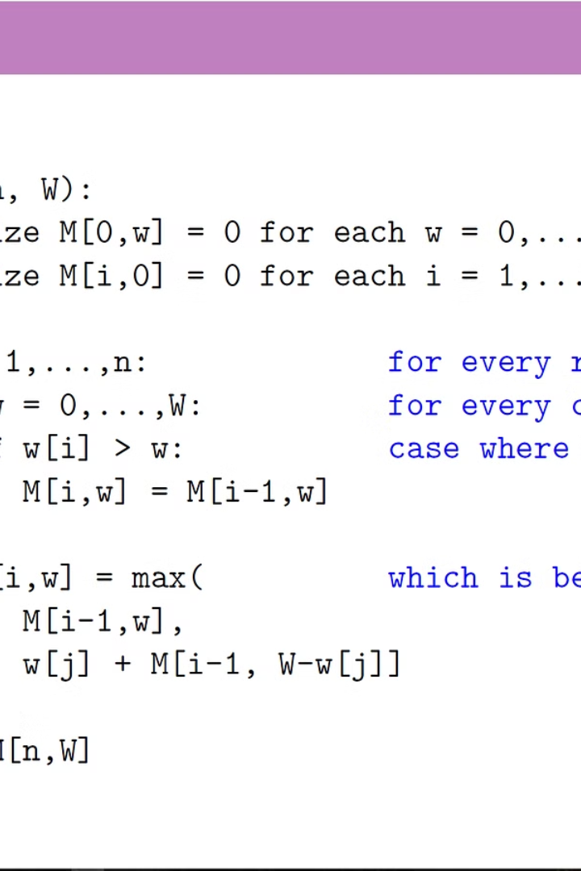
Why Pseudocode is Important
Pseudocode, an informal programming language, improves human comprehension by providing a plain English representation of complex software (geeksforgeeks, 2023).

Slide 11

Flowcharts: A Visual Representation
1
Useful Tool
2
Symbols
3
Program Flow
Flow charts are useful tools that represent the program flow in symbols or visual format.
Flow charts use symbols to connect the technical and non-technical persons to create a program and understand its flow.
Flow charts help to fix issues in a program and monitor its flow, connecting different elements and processes.

Slide 12
Starting the Voting System
1
Step 1: Software Initialization
Start the voting software to initiate the voting process.
2
Step 2: Admin or Voter
Choose between admin and voter to proceed with the voting system.
3
Step 3: Admin Options
If admin is chosen, provide a PIN for validation and access various options like creating voters, candidates, and elections.
4
Step 4: Voter Options
If voter is chosen, authenticate and proceed with options like registering to vote, editing profile, and displaying vote.

Slide 13
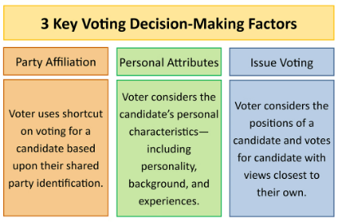
Admin Options in Detail
Create Voter
Create Candidates
Create Election
Admins can create new voter profiles in the system.
Admins have the option to create new candidates for the elections.
Admins can set up new elections within the voting system.

Slide 14
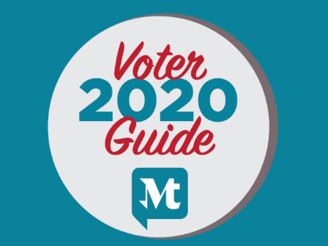


Voter Options in Detail
Register to Vote
Edit Profile
Display Vote
Voters can register to cast their votes in the elections.
Voters have the option to edit their profiles within the voting system.
Voters can view and display their votes within the system.

